Slide 1

50flPCbKO'i MICbKO'f PAA

Slide 2


Ko)l(Ha cyqacHa IIIKOJia 3a cBoero
c)?iJiococ)?ieIO IIOBHHHa 6yTH
iHKJII03HBHOIO. Qe 03Haqae rOTOBH CTb,y
6y b-5IKHiIqac, rrpHiIH51TllKO)l(HY HTHHy,
rrparHyqH CTBOpHTH MaKCHMaJibHO
....
crrpH5ITJIHBe cepe,ri:OBHme ,LJ:JI51 p03BHTKY 11
•
IIOTeHQ aJiy.

Slide 3



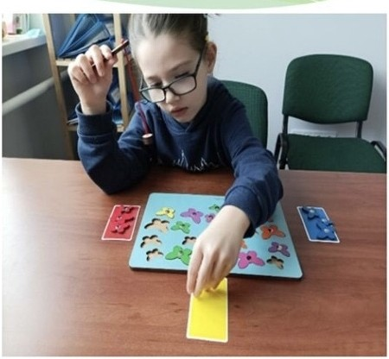
* ):( TH 3 MOBJICHHCBHMH nopymeeeSIMH.
* ):( TH J JaTpHMKOIO ncnxi11eoro p03BUTKy.
* ):( TH 3iHTCJICKTyaJi hHUMU
nopymeBBSIMU.
* ):( THlnopymeBBSIMH 30py.
):( TH J nopymeBBSIMH cJiyxy.
):( THi1nopymeuBHMH onopuo-pyxonoro anapary.
*
*
*
):( THlpauniM .r.nTSl'IUM ayTHJMOM, p03Jia.r.aMH cneKTpa 3YTH3My.
):( TH j3 r nepaKTHBHiCTIO Ta .r.e«t>in.uTOM ynaru.
):( TH 3 nopymeHBSIMH none.r. BKH.

Slide 4


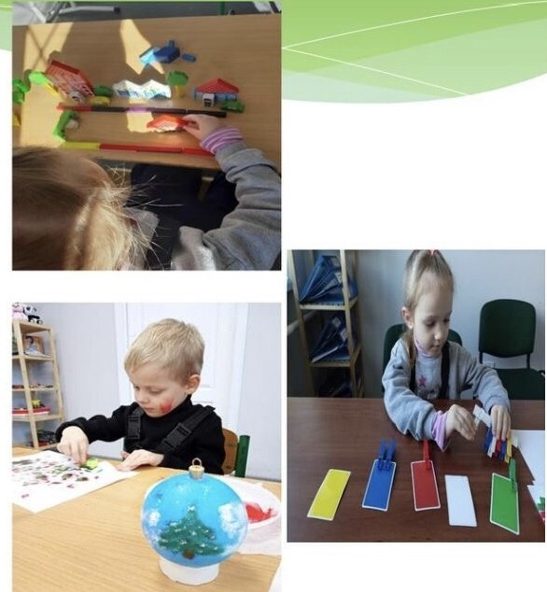
Ha BHKOHamur BHMOf IIOCTaHOBH Ka6iHe'Ij'
MiH cTpiB YKpai'HH Bi.n 12.07.2017 poicy N2 545 (iJ 3Mllia.MH)«lpo 3aTBep.n)KemrnIIono)KeHIDl rrpo imu:rIOJHBHO-pecypcmrii: [(eHTp» Ta 3 MeTOIO 3afie3neqeHIDI npasa oci6 3 oco6JIHBHMH ocBiTHiMH norpe6aMH Ha 3,no6yrrn .nomKiJibHoi' Ta 3araJibHoi' cepe,[\HbOlOCBiTH,B TOMY q:HCJii y 3aKJia,nax
rrpocpecifmoI(npocpecifmo-TeXHiqHo ),cpaxosoI BHTI.\OlTa nepe,l(BHiqOlOCBiTH,m<i 3afie3rreqy10n 3,n;o6yrrg OCBiTH,lliJ!gXQM rrpose,n;eHH$1 KOMITJieKCHOl
ncHXoJioro-rre,n;aror qffoIoniHKH po3BHTKY oco611Ta 3a6e3rreqeHIDJ i'x CFICTeMHOfO KBaJii<l?iKoBaHoro cynposo,zzy, pimeHH$IM qeprosoI6 cecii' :Oogpcr:.1<01 MicI>KoIpa,LUI VIII CKJIHKaHIDI N26/222 si.n 25 n10roro 2021 poicy «lpo 3aTsep):()KemurIIporpaMH po3BHTKY
iHKJII03HBHOlOCBiTH «IBKJII03HBHO-pecypcIDiii: [(eHTp
EoJq>CbKOi' MicI>Koi' pa,nH» cTBopeHo KoMYHailbHY
ycTaHOBy « HKJII031I' BHO-pecypcH1IlineHTp ])ogpCbKOl
MiciiKOi' pa,IUi».Y csorn)lUurbHOCTi IPU
rri,n;rropMKOBYE: bCH Bi oBi,n;HHM o6JI CHHM . CTpYKT}'PHIIM II,l(p03,l(lJiaM 3 ITHTaHD )J;illJ!bHOCTl
[(eHTpy,a CaMe o6naCHOMJ QeHTpy rri,nTpHMKH iHI<JII03HBHOlOCBiTH,.nenapTaMeH'Ij' OCBiTH
KH:iBCbKOlo6naCHOl,nep)KaBHOla,n;MiHiCTpan ,
MiHicTepcTBy ocsimiHaYKH YKpa"iHH. 3acHOBHHKOM QeHrpy € EoJq>CbKa M cbKa pa,na.

Slide 5

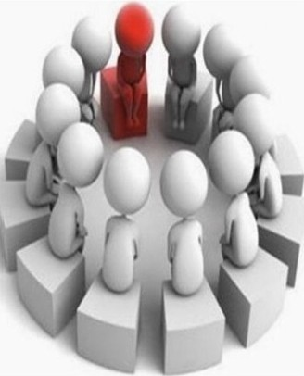

*BqMTeJih-,IJ;e<P eKTonor
*BqMTeJih-nororre,IJ;
*IlcMXOJIOr

Slide 6

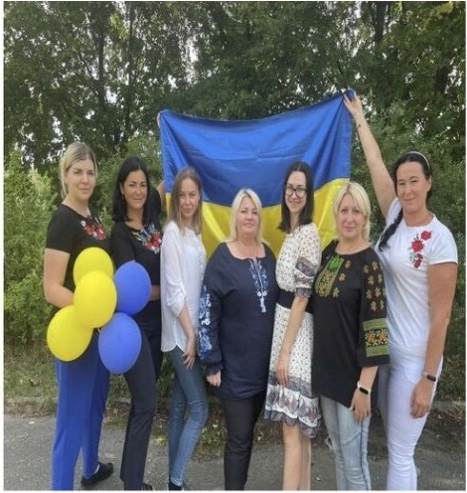
Po6ory Hamoro u;eHTpy 3a6e3neqyrori> ne.uaroriTIHi
.
npau;lBHHKH:.uHpeKTop,BqHreni>-norone.n,BqHTe.Jlb-
.ue<PeKTonor,npaKTWIHHii ncHXonor, BaKaHTHe Micu;e BqJITeIDI-pea6 n Tonora. 1(eHTP <PYHKUioeye Ha 6a3i
rrpHMim:eHIDI Eo5Ipci>Koro aKa,neMiqHoro niu;e10
«lpecTIDK", 3a a.upeco10: Byn. E. XMen1>HHUJ>Koro, 57A, M. Eo5IpKa, <I>acT Bc1>Koro palioHy,KH:mci>Koi: o6nacTi,08150. Mae oKpeMHM Bxi.U,o6na,nHaHHM
n .uiloMHHKOM. CTBopeHo cTopiHKY y ¢ei1c6irri.u Ha3BOIO KY « HKnI03HBHo-pecypcHHii u;eHTp Eo5Ipci>Ko1Mici>Ko1pa.UH». ,[(IDI rrpocBiTHHUJ>Ko1
po60TH Ta 3BOpOTHhOTO 3B'5!3K)' Ma€MO ocpi:u:iHHHH
cailT (http:// rc-boyarka.zzz.eom.ua/), .ne MO)KHa 3HaHTH BCIO .neTa.TlbHJ', a TaKO)K KOpHCHY
iHc}?opMau; IO, 5IK rrpo I(eHTp TaK irrpo HOpMaTHBHY
6.a3y IBKnl03HBHOro HaBqaHIDI,BHMOrH Ta 6araTO
lHllloro.

Slide 7
•• IlpoBe,[(eHH5.l KOMIIJieKCHOl
rrcnxonoro-rre,naror1•qH0•1• OIJJHKIIp03BllTKY ,[(IITIIHII.
I • ft
•
•!BH3Haqe.HIDI rrc11xonoro-
rre,naror1qHoro Ta
.'-'
KopeKI( llHO-p03BIITKOBOro MaprnpyTy ,[(JUI ,n Tett 3 00II.
•!3a6e3rreqeHIDI CHCTeMHOro KBan cpiKoBaHoro cyrrpoBO,[(Y ,[(,IITIIHII.

Slide 8

:-' 3BepHeHIDI 6aTbKiB (O,[(Horo 3 6aTbK B) a6o 3aKOHHHX
•
npe,[(CTaBHHK B ,[(HTHHH;
>.- oco6ncTe 3BepHeHIUI oci6 BiKOM Bi.I( 16 poK B;
* 3BepHeHH.SI a,n:MiH crpa l3aKJia,n; B OCB TH (3a Ha.SIBHOCTi 3rO,[(ll 6aTbKiB (O,[(Horo 3 6aTbKiB) a6o 3aKOHHHX npe,n;cTaBHHKiB
,[(HTHHH);
* 3BepHeHHH opraHI
• • •
B OillKH Ta IIIK.rryBaHH.SI ru:o,n:o npoBe,[(eHH.SI
KOMITJieKCHOoiHKH
,n: Teii-cnp T,,n:iTeiiIl036aBJieHHX
6aTbKiBcbKoro n KJI)'BaHHH.
> •¥

Slide 9


* ou;iHKa cpi311qHoro po3BHTKY ,[(llTMHll
* OIJ;IHKa MOBileHHE'.Boro po3BHTKY ,ll;llTHHll
•
* ou;iHKa KOf HiTHBHOl ccpepH ,[(HTHHH
ou;iHKa eMOIJ;iHHO-BOilbOBOl ccpepH ,[(llTHHll
ou;iHKa OCBiTHbOl ,n;i.HilbHOCTi ,ll;llTHHll
Yci nanpRMu OUriH10aaHHJl .JJ.ta10mb 6ymu cnpRMoaani na 6U3Ha'leHHJl no3umua11ux cmopiH p036UmKy oumuHu, JlK OCH06U OllJl ii' noOa!lbUIOZO p036UmK)l, HQ6'laHHJl ma ouxoaa111111 i 6U3Ha'leHHJl Ul.JIRX)l KOMnencaUrif cna6Kux cmopin 3a pf!:XYHOK CU!lbHUX.
I(eu 1wzax nponucyt-ntbCH <jJaxiat(llM.U y aucnoBKJJ KOMIIJIEKCHOI OI(IHKH, a1<a
ouoaembCR 6ambKa.M ma 3alOlaOa.M ocaimu Ollapea!li3aUrif i 6UKopucma111111.

Slide 10

Ha;:i:aHHH rrcHxoJioro-rre;:i:aror qHHX,
."
KOpeKQ HHO-p03BHTKOBHX rrocnyr iT.HM 3 OOII
3a pe3YJibTaTaMM KOMrrneKcHo1ol( HKM cpaxiBI(iIPL(:
BM3Ha1IaIOTb HaIIpHMM Ta o6cHr Ha,[(aHHH IICMXOJIOfO-
• • v •
ne,n:aror11IHHX, KopeKI( HHO-p03BHTKOBHX IIOCJiyr JJ:lTHM 3
oco6JIHBHMH OCB TH MH IIOTpe6aMH.
IlcuxoJioro-ne,lJ;aroriqui, KopeKi.-iii uo-po3BHTKOBi nocJiyru
H3)1;3IOTh CSI )J;iTSIM 3, 0011,
HKi HaB1!aIOTbC51 y 3aKna,n:ax
.
.. . ..
. .""
,[(OIIIK JibHOI,3af aJibHOlcepe,[(HbOl OCB TH,KOpeKI( HHHMH
rre,n:aroraMM 3aKna,n:iB Ta 3 11Hcna cpaxiBI( B IPL(, IIIJ15IXOM YKna,n:aHHH yro,rr: rrpo Ha,rr:aHH51 rrocnyr,51Kll(O HeMae 3MorH
oTpnMysaTu sm• nosm• uo•1• .r.onoMorn
•
B caMoMy 3aKJia,JJJ.

Slide 11

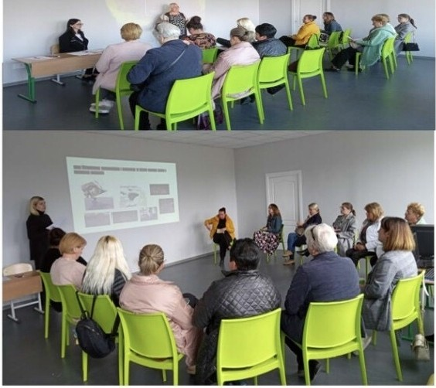
I .Cnianpau;51 3 rre.n;aroraMH,6aTbKaMH.
•! Ha,n;aHIDI MeTo,n;H..qHo1,
. ..
KOHcyJibTaTHBH01,f!CHxonor1qH01
)l;OIIOMOrH rre.n;aror1qHHM rrpau; BHHKaM,6aTbKaM.
•!IIpoBe.n;eHH5I rpyn 3ycTp qeii 6aTbKiB,,cynepB 30£CbKrpyrr )l;JI5I rre.n;aror1qHHX npau;1BHHK1B.
2. YqacT:b B TeMaTH HHX Hapa ax,
.
.
ceM1Hapax, 3ycTp1qax .

Slide 12
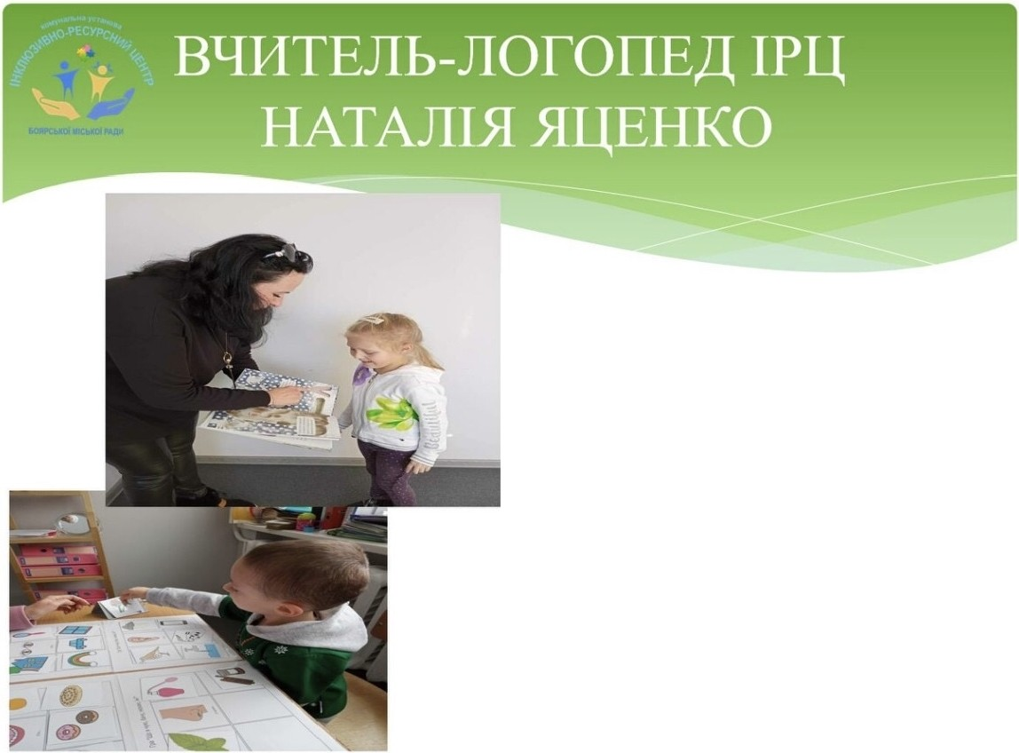
3 MOMeHTY
KOMIIJIeKzyBaHH51
rre,n:aror1qHoro KOJieKTMBY
:o;eHTpy, (a :u:e,rrpM6JIM3HO,
piK TOMy),HamoIO yBaroIO 6yJio OXOIIJieHO IIOHa,n: 200
,n:iTeli. TaKO)I( rrpoBOJJ:MJIMC51
BHl3Hi 3aci,n:aHH51 cpaxiB:QiB
•
IPL( B 3aKrra,n:ax ,n:omKiJinHOI OCB TM.
•

Slide 13
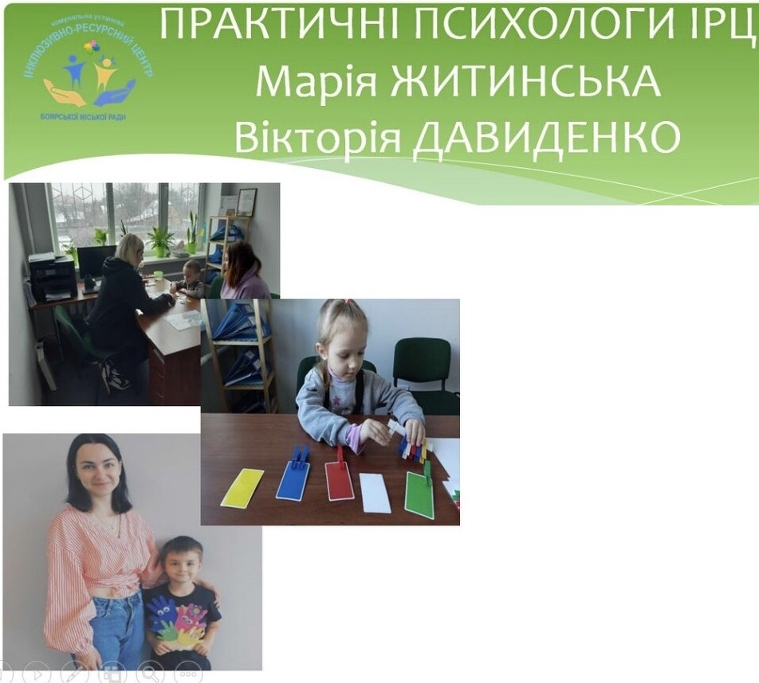
3,£J,ii1CHl-Ol-0Tb nepB"1HH"1i1 np1tti10M 6aTbKiB a6o 3aKOHH"1X npe,£J,CTaBH"1KI B ,£1,Vt TlllHVt.
* npoBOARTb AiarHOCTV14HY ou,iHKY
•
• ... • v • •
KOfHITVtBHOI Ta eMOU,IVt H0-80/lbOBOI
ccpep111 ,ll,"1TV1H"1 3 MeTOl-0
B"13Hal.leH. HF1 piBHR ccpopMOBa.HOCTi
TaK1t1X nt3Hasa11bH"1X npou,ec1s, RK cnp1tt i1HRTTF1,naM¹F1Tb,M"1ClleHHF1, yR sa, ysara. Ha,D,aK)Tb KopeKu,ii1Ho­ po3B"1TKosi noc11yrl1 oco6aM 3
oon.

Slide 14



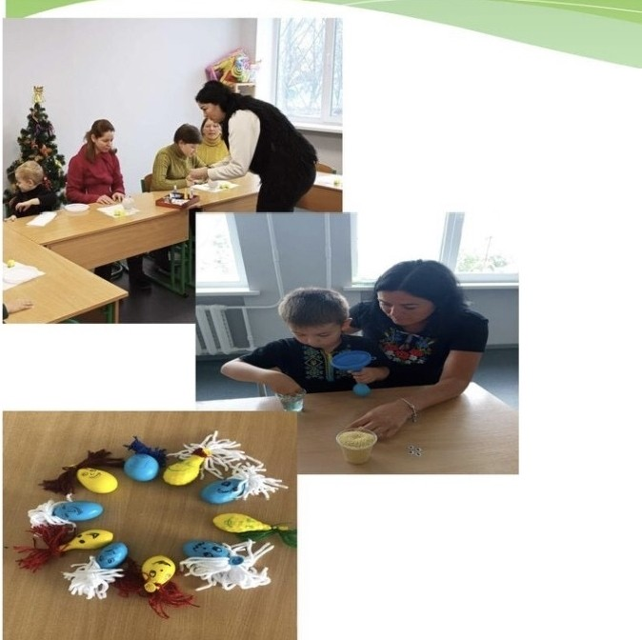
OcHOBHe 3aB):(aHIDI
):(e<l>eKTOJIOfa - ne ):(OIIOMOITH
):(HTHHi3 oco6JIHBIIMII
IIOTpe6aMH con aJi 3ynaTHC5I,
•
HaBqHTIIC5I )l(IITII31CBO€IO
oco6JIIIB cTIO, 3p03)'M TH i
rrpHHH51TH ce6e.

Slide 15





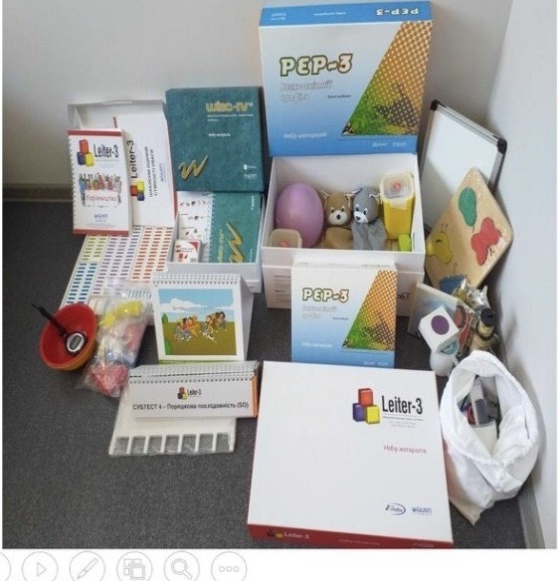
3ri)U{o npoBe.neHHx MiHicTepcTBoM ocBiTH iHa)'KH YKpa1HH .nep)KaBHHX 3aKyn BeJI1>, Ham PU OTpHMaB
HOB THi,H.aHKpamoro CB TOBoro 3pa3Ka TeCTH,fil(J. .[{03BOID110Tb npoBeCTH
<jJaKTHqHo Beeb cneK.TP Il0Tp 6HHX
.
11CHXOJIOro-rre,n:aror1qHHX .[{OCJl .[{)KeHb.
Ue.,n:y)Ke Ba)KJIMBO .[{.JI.sr Toro, mo6
OU HHTH crrpoMO)KH CTb .no HaBqaHH.sI
,n: TeH 3 oco6JIHBHMH OCBiTHiMH
1.10Tpe.6aMH,rro6y,n:yBaTH ,n:IDI HHX lH.[{HBIJJ:YaJihH)' rrporpaMY p03BHTKy,
ocBiTHJO TpaeKTopiro Tomo. H.n;eT1>c.sr rr. o KOMI1'lOTepH30BaHiTeCTH. .[{JI.sr
,n:1arnocTHKH 3a IIIKaJiaMH ou1H10BaHH.sI BeKcJiepa,JieiiTepa,KoHHepca Tomo.

Slide 16


o:u;iuicy p03BHTKY oco611 IIpOHIIIJIH 226
KoMnJieKcHy ncHxonoro-ne aroriqey
,n:iTeii (+3 IJOBTOpHo)
HamHM IPII; rrpoBe,n;eHo rroHa,n;
220 KOMITJieKCHHX o
u; HOK ,n Teif,
Ki MaIOTb Ti qif HIIIinpo6neMH ioco6JIHBOCTi p03BMTK)',3 HHX
• • •
BCTaHOBJieHO p BHlIl,IJ;TpHMKH
143 oco6aM,
Ki MaTMMYTb
• •
3Mory OTpHMaTM OCB THlTa
• \J •
KopeKIJ;IHHO-p03BHTKOB1
nocnyrM,BpaxoByioqJI
iH,JJ;HB ,nyanbHioco6JIHBOCTi KO)l(HOro.

Slide 17
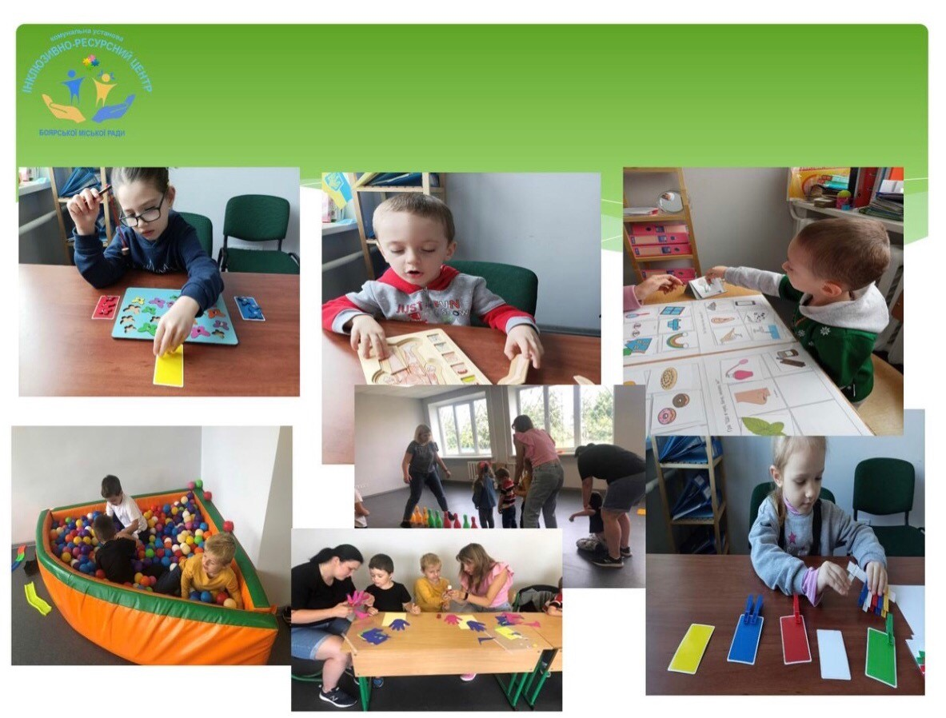

Slide 18

,[(iTH ,L(OlllKiJJhHOf O BiKy
,[(iTH lllKiJJhHOf O BiKy
5 3aKJia,n;iB ,[(OIIIKiJinHOl OCBiTH B HHX 14
•
1HKJII03HBHHX rpyrr, ,n;e
7 3aKJia,n;iB 3araJII>HOt
••
•
cepe,[(HbOl OCBlTH, ,z:i;e
HaJii"CJ)7£TbC51 25
BHXOBYE:TbC51 32
,[(HTHHH.
• •
1HKJII03HBHHX KJiaCIB, B
51KHX HaBqaeTbC51 26
•
yqHIB.
)

Slide 19



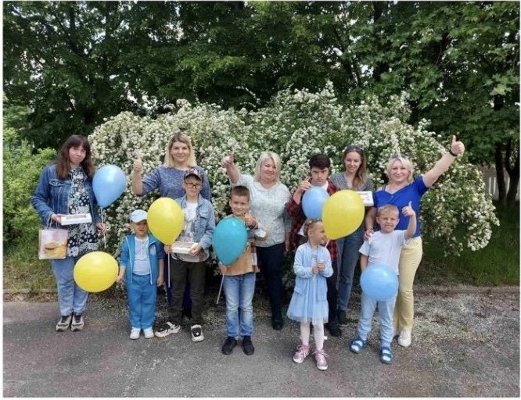
<<HAIIlA META
IIOllilfA€ HE B TOMY, IJJ;OB BYTH IIOTPIEHI1MI1 HAIIlIIM IT5IM, A B TOMY, IJJ;.O. B HABqJITH IX
lllBHlllE
OBXO MTMCb BE3
HAC>>

